Slide 1

TIC-TAC-TOE
Tic-tac-toe
TEAM MEMBERS:
GUIDE’S NAME
k.Siddhartha(2451-10-737-081)
k.Mounika (2451-10-737-080)
s.Shravya (2451-10-737-086)
G. Ushasri
Designation: Asst. professor,
Department of Information Technology

Slide 2
Statement of problem:
Games like su-do-ku, tic-tac-toe and chess increases the ability of thinking in every individual (specially in children). People getting bored with their daily work try to refresh themselves by playing games(one of the means of refreshment). But there may be situations when they are single and cannot access games like these. So there is a need for artificial intelligence in the absence of others. Hence there is a need to develop games like these in pc
Scope of work:
*Creation of single player and two player game.
*taking the inputs and checking the conditions for result.
*developing artificial intelligence
*linking all the functions
*performing all the operations in c++

Slide 3
j individual contribution
Game data: -dividing the program into 2 divisions
1-player game
2-player game
Intake inputs: -getting input from the user and interlinking that
with the present board
Computer moves: -developing the conditions for the computer
moves
-algorithm
-checking the conditions for computer to win
-checking the conditions to block the player-1
moves
-random selection, if all the conditions fail

Slide 4
ABOUT THE GAME
1 .Every player is given an alternate choice to fill their
symbols (x or o) in provided slots(once the slot is filled it
cannot be re-filled)
2.Whoever fills the slots first with their symbols in such a
way that any 3 of them are consecutive( horizontal or
vertical or diagonal) will win the game
3.If none of the 2 players can do it then the game is draw
X X O
X O X
O * O
O’s won the game

Slide 5
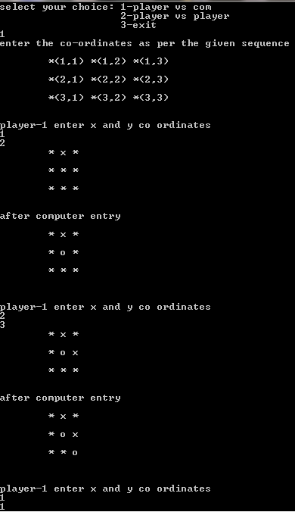
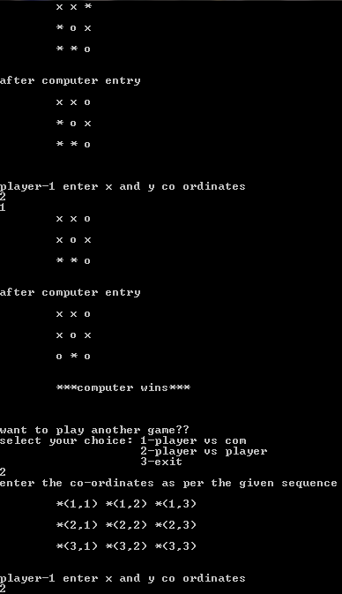

Slide 6
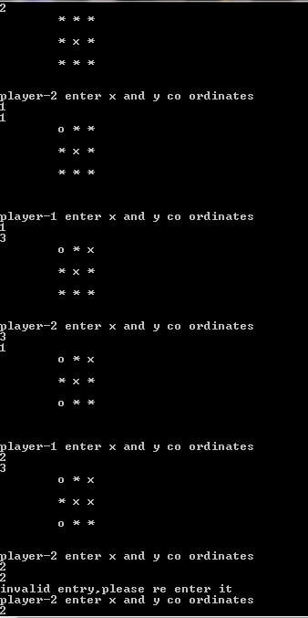
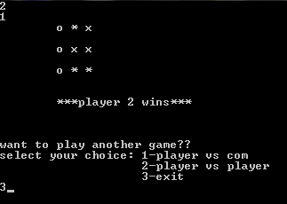

Slide 7
FUTURE DEVELOPMENTS
*Adding AUDIO effects to the game
*Including selection options for the players replacing
x and o’s with other symbols
*Including graphics to the exiting program for the
betterment in output

Slide 8
Thank you
Presented by:
siddharth

